Slide 1

Parking Slot Booking System (PARKIT)
Under the Guidance of
Guide Name: Mr. Ch. Anil Kumar
Designation: Assistant Professor
Team:
16WH1A1206 - A. Yasaswini
16WH1A1227 - K. Sunvitha
16WH1A1237 - K. Soundarya
16WH1A1252 - P. Swetha

Slide 2
Contents
Introduction
Problem Definition
Solution
Requirements
Features
Flowchart Diagram
Module(s)
Output screen
Plan of Action
Conclusion
References

Slide 3
Introduction
Currently, most of the existing parking systems are manually managed and a little inefficient. In urban areas, where number of vehicles is higher as compared to the availability of parking spaces, a lot of time is being wasted in searching for slots. Hence Online parking slot booking system is proposed.

Slide 4
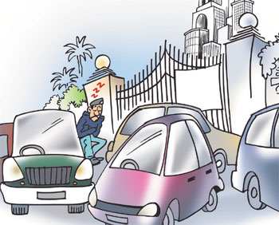
Problem Definition
In the modern society, there is an ever-increasing number of vehicles. This is leading to problems such as valuable time wasted from inconvenient and inefficient parking lots, more fuel consumed while idling or driving around parking lots, leading to more CO₂ emissions being produced, Accidents caused by abundance of moving vehicles in disorganized parking lots.

Slide 5
Solution
Proposed system assists the driver in finding a vacant place in a short time. The most essential features is to detect present available parking spaces and provide various kinds of parking space. After finding the preferable space the drivers will follow the procedures for booking if there is a vacant space. This system will probably reduce time, cost and effort for finding a vacant place. Both car park operators and drivers will benefit from the system as parking spaces are easily acquired and parking space wastage is reduced.
PARKIT

Slide 6
Requirements
Operating system : Windows XP/7/10
Development kit : Android Studio
Technologies used : Java and React JS

Slide 7
Features
Booking slot
User Details
View available parking slots
Recent Bookings Display
Displaying details along with QR Code
Cancellation of slot

Slide 8
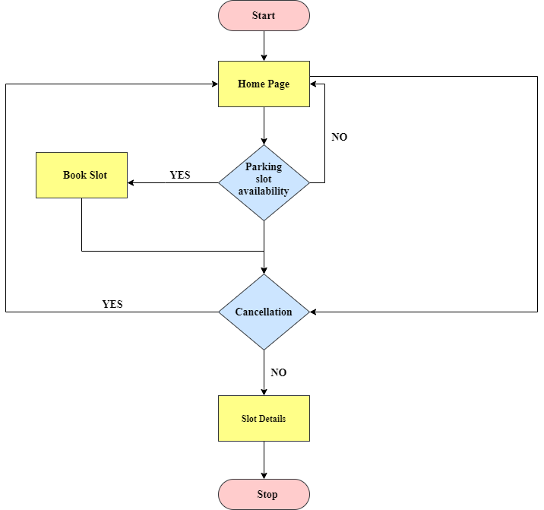
Flowchart Diagram

Slide 9
Modules
User and owners login/registration
User Information (Details like, License number and picture are to be uploaded)
Search parking availability
Parking booking online for date and time
Confirmation on successful booking

Slide 10
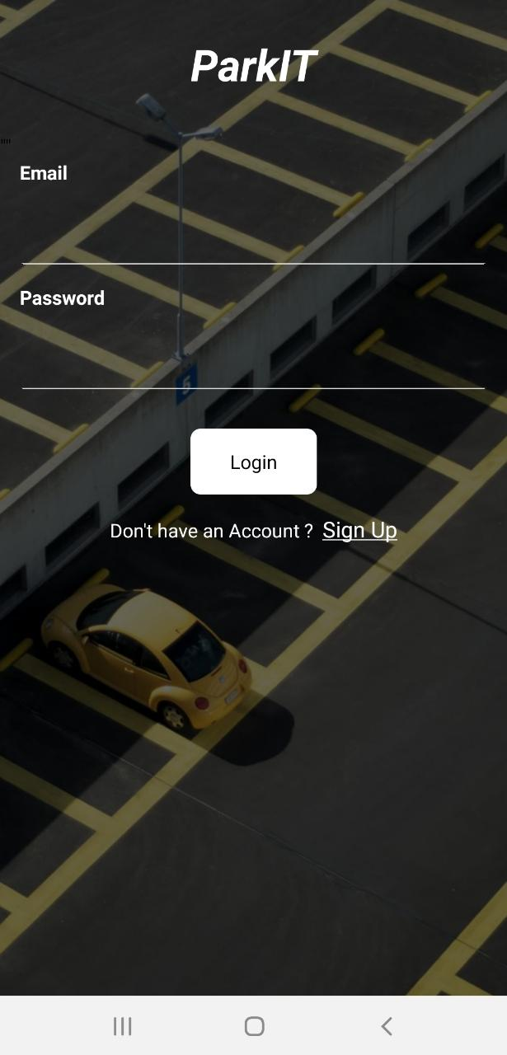
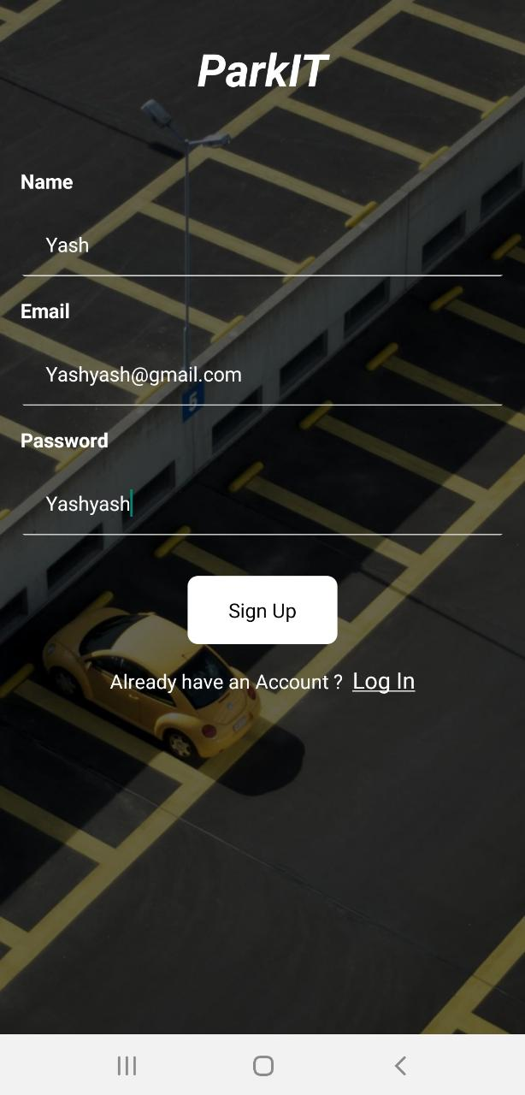

OUTPUT SCREENS
LOGIN
AND
REGISTRATION

Slide 11
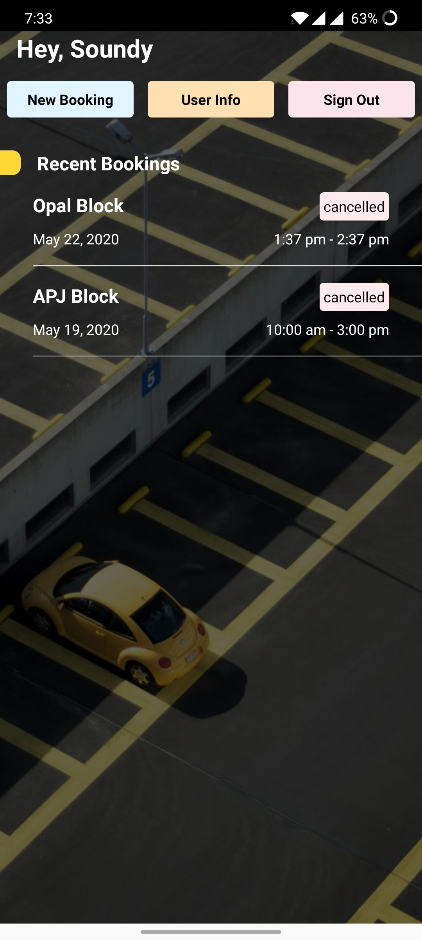
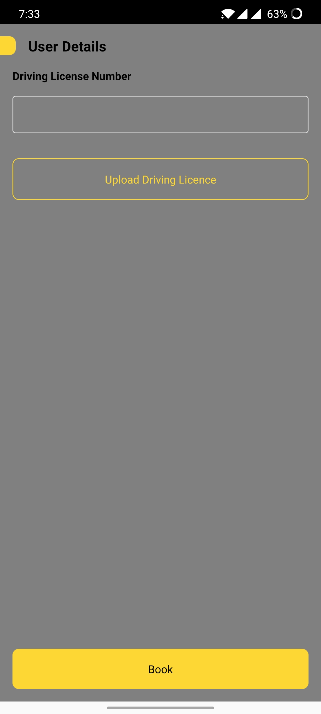
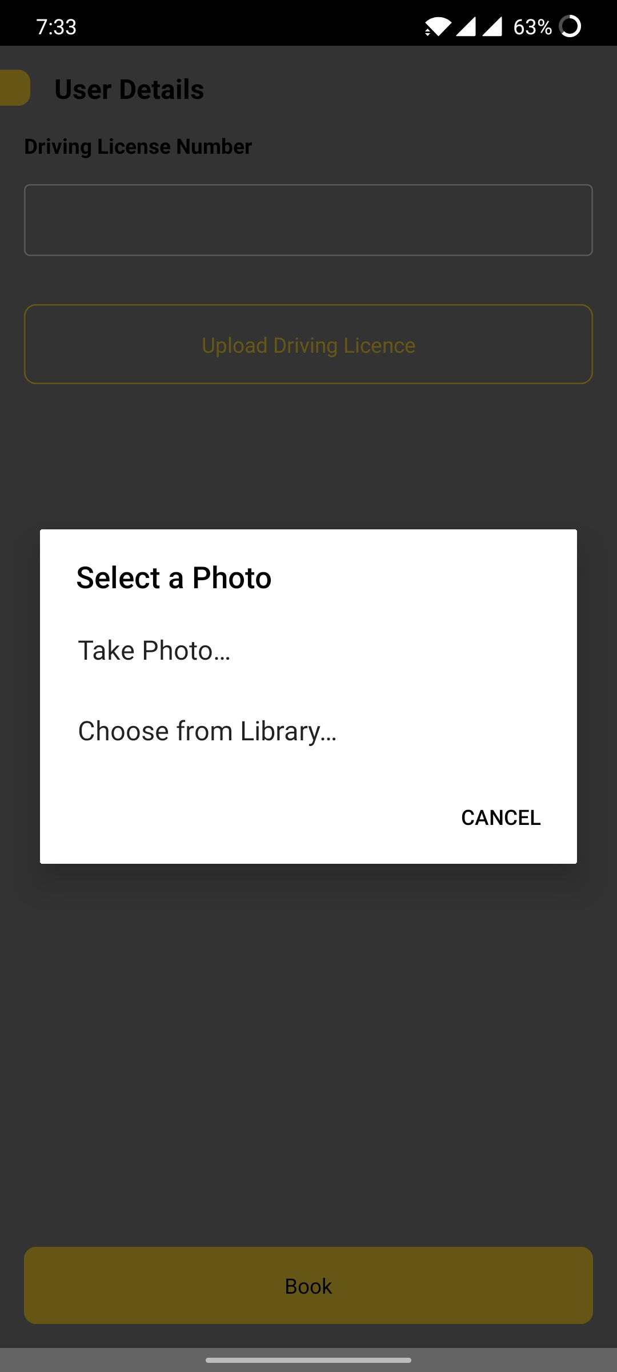
OUTPUT SCREENS
USER DETAILS

Slide 12
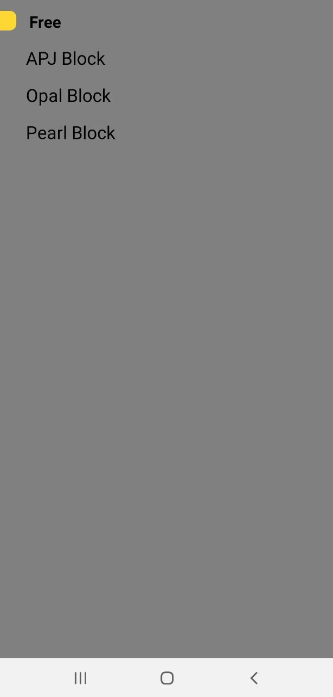
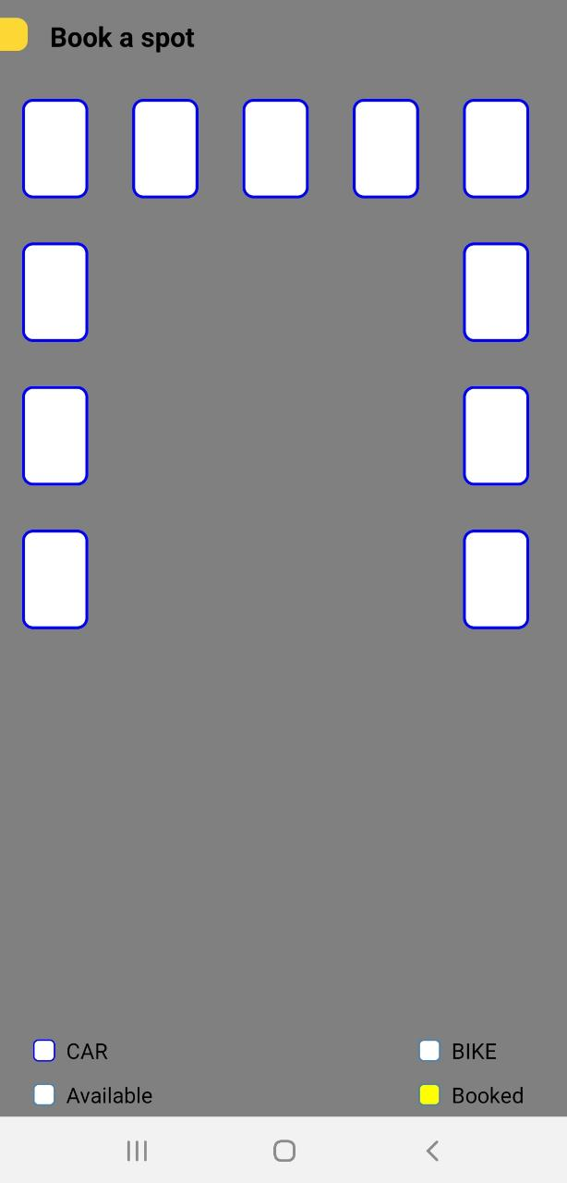
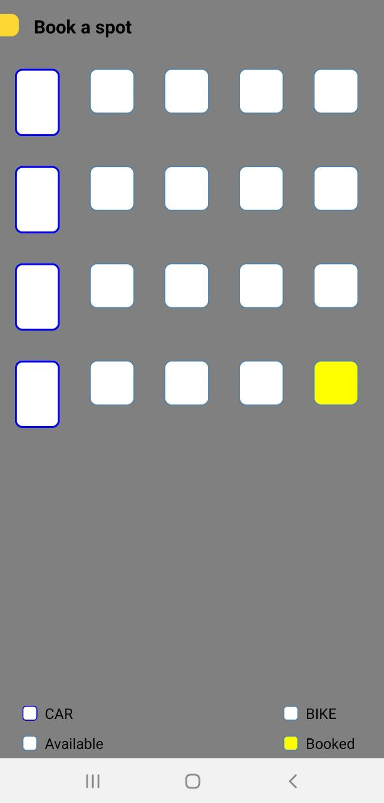
OUTPUT SCREENS
PARKING
AVAILABILITY

Slide 13
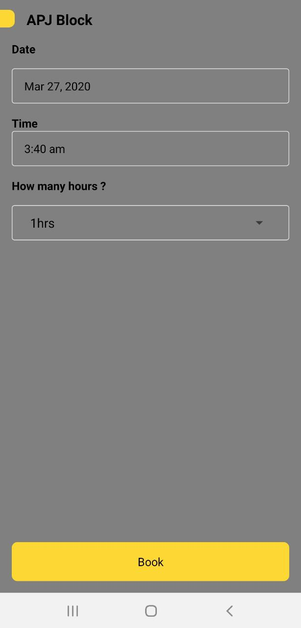
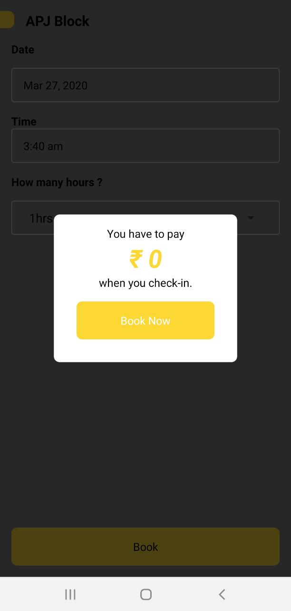
OUTPUT SCREENS
BOOKING

Slide 14
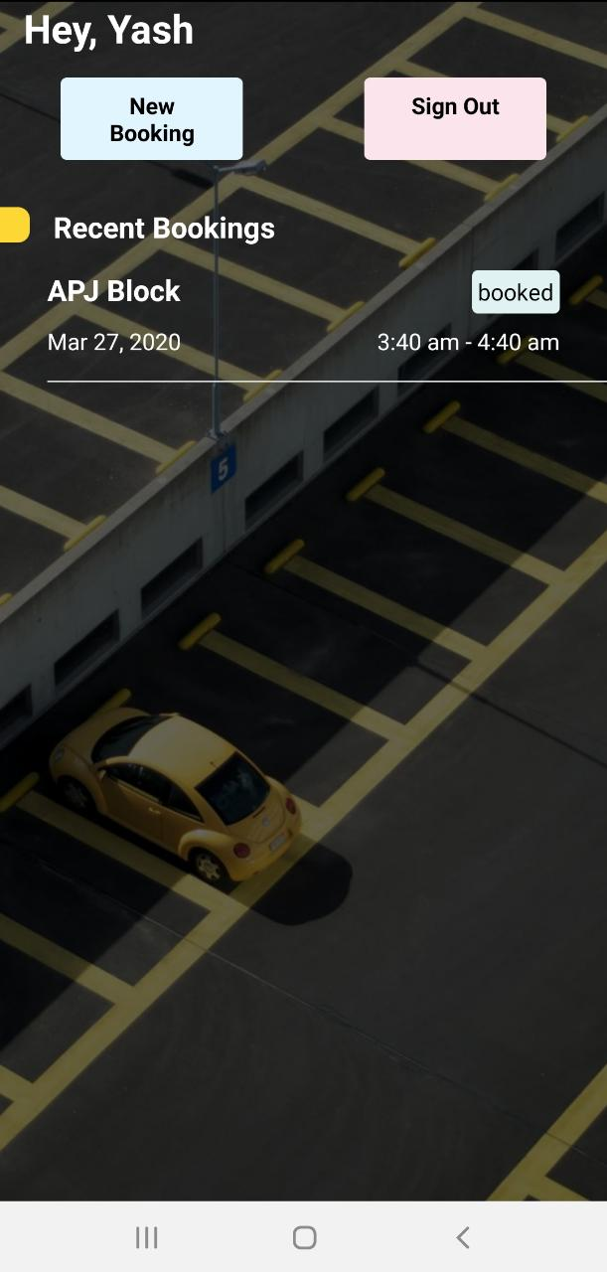
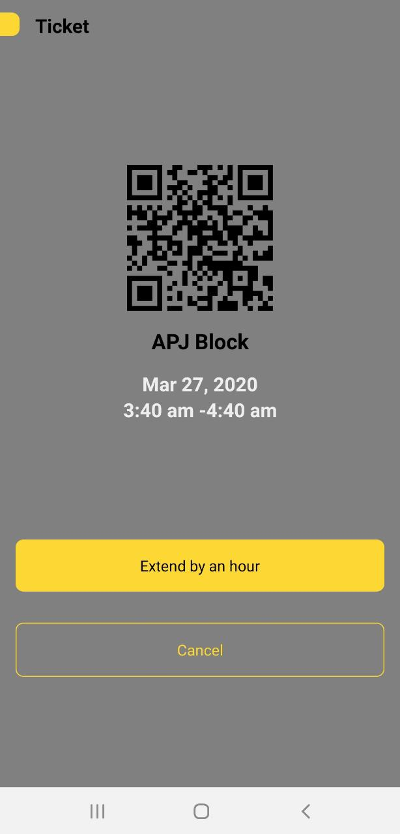
OUTPUT SCREENS
SUCESSFUL BOOKING

Slide 15
Action Plan
Module Information | Status | Time required to Complete
Literature Survey | Completed | 1 Week
Requirement Analysis | Completed | 1 Week
Design | Completed | 2 Weeks
Implementation | Completed | 4 Weeks
Documentation | Completed | 2 Weeks
Final Submission

Slide 16
Conclusion
Online Parking Slot Booking System improves the existing system since we are in computerized world. With this new system is mandatory, it enables the user of the system to reserve a parking lot online and this reduces the wasting of time of the clients looking for where to park, increase the safety of the property since the parking lot is numbering.

Slide 17
References
[1] https://www.ijraset.com/fileserve.php?FID=6482
[2] http://www.ijirset.com/upload/2015/october/86_A%20Survey.pdf
[3] Andre Barroso, Jonathan Benson, Tina Murphy, UtzRoedig, Cormac Sreenan, John Barton, Stephen Bellis, Brendan Flynn, and Kieran Delaney, “The DSYS25 SensorPlatform,” t Ireland,2004
[4] B. Yan Zhong, S. Li Min, Z. Hong Song, Y. Ting Xin, and L. Zheng Jun, “A Parking Management System Based on Wireless Sensor Network,” tech. rep., Institute of Software Graduate School of Chinese Academy of Sciences, Beijing, November 2006
[5] Vanessa W.S Tang, Yuan Zheng, and JiannongCao,“An Intelligent Car Park Management System based on Wireless Sensor Networks,” tech. rep., Internet and Mobile Computing Lab, Department of Computing, The Hong Kong Polytechnic University, P.R.China, August 2006.
[6] ZigBee/IEEE 802.15.4 Summary, “SinemColeriErgen,”tech. rep., EECS Berkely, September 2004.ech. rep., University College, Cork, Irelandand National Microelectronic Research.

Slide 18
Thank you

